Slide 1
Searching in a Graph
CS 5010 Program Design Paradigms “Bootcamp”
Lesson 8.5
© Mitchell Wand, 2012-2016
This work is licensed under a Creative Commons Attribution-NonCommercial 4.0 International License.
TexPoint fonts used in EMF.
Read the TexPoint manual before you delete this box.: AAA

Slide 2
Introduction
Many problems in computer science involve directed graphs.
General recursion is an essential tool for computing on graphs.
In this lesson we will design a program for an important problem on graphs, using general recursion
The algorithm we will develop has many other applications.

Slide 3
Learning Objectives
At the end of this lesson you should be able to:
explain what a directed graph is, and what it means for one node to be reachable from another
explain what a closure problem is
explain how each of our functions for reachability works.
explain the correctness and termination of each of our algorithms by referring to their invariants.
write similar programs for searching in graphs.

Slide 4
Warning: this is a hard lesson
This lesson unifies a number of really important concepts.
It deals with graphs, which you should have seen before. If you haven't, go find a discrete structures book and read about them.
It introduces a kind of halting measure that we haven't seen before ("the number of things that aren't there")
It uses invariants in a much deeper way than we've seen before.
So sit down, print out this lesson so you can write on it, and study it carefully. You will find it well worth the effort.
If you don't have questions after you've read this lesson, then you haven't read it closely enough.

Slide 5
Lesson Outline
Introduction/Review of directed graphs
Design of two algorithms for reachables.
Design of an algorithm for reachable?
Representing graphs as functions.

Slide 6
What's a graph?
You should be familiar with the notion of a graph from your previous courses.
A graph consists of some nodes and some edges.
We will be dealing with directed graphs, in which each edge has a direction. We will indicate the direction with an arrow.

Slide 7
A Graph
nodes: A, B, C, etc.
edges:
(A,B), (A,C),(A,D), etc.
A
B
C
D
E
F
G

Slide 8
successors of a node
The successors of a node are the nodes that it can get to by following one edge.
(successors A) = {B,C,D}
(successors D) = {C,F}
A
B
C
D
E
F
G

Slide 9
all-successors of a set of nodes
A
all-successors of a set of nodes are all the successors of any of the nodes in the set
(all-successors {}) = {}
(all-successors {A,D})
= {B,C,D,F}
B
C
D
E
F
G

Slide 10
Paths in a Graph
A path is a sequence of nodes that are connected by edges. Notice that the node A by itself is a path, since there are no edges to check. On the other hand, (A,A) is not a path, since there is no edge from A to itself.
A
B
C
D
E
F
paths:
(A,C,E)
(B,C,E,G)
(A,D,C,E)
(A)
non-paths:
(D, A)
(A,C,G)
(A,C,D,E)
(A,A)
G

Slide 11
Cycles
This graph has a cycle: a path from the node B to itself. Graphs without cycles are said to be acyclic.
For this lesson, our graphs are allowed to have cycles.
A
B
C
D
E
F
G

Slide 12
Reachability
One node is reachable from another if there is a path from the one node to the other.
A
B
C
D
Nodes reachable from D:
{B,C,D,E,F,G}
Not reachable:
{A}
E
F
G
D is reachable from itself by a path of length 0, but not by any other path

Slide 13
Another classic application of general recursion
reachables :
SetOfNode Graph -> SetOfNode
GIVEN: a set of nodes in a finite graph
RETURNS: the set of nodes that is reachable in the graph from the given set of nodes

Slide 14
Definition
A node t is reachable from a node s iff either
t = s
there is some node s' such that
s' is reachable from s, and
t is a successor of s'.

Slide 15
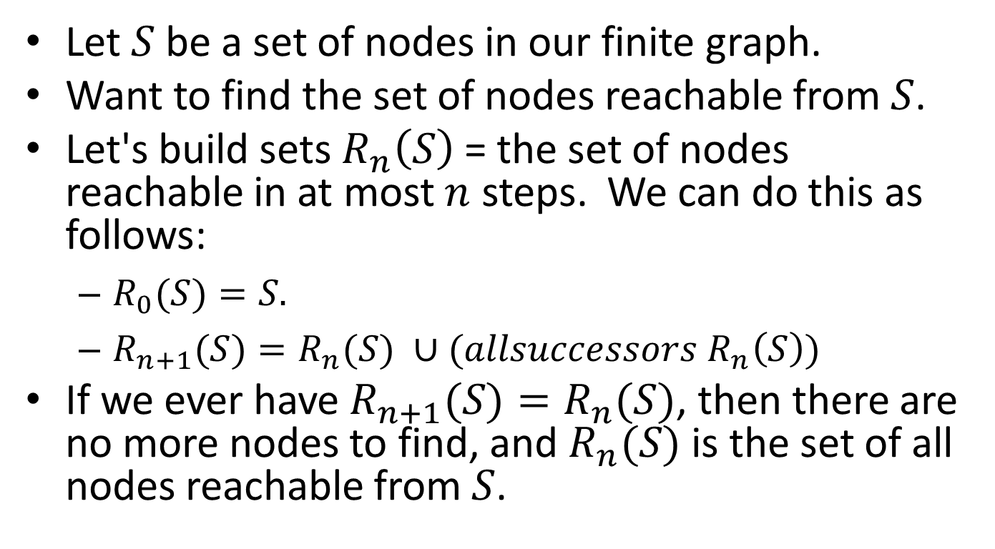
Enumerating the elements
Let $S$ be a set of nodes in our finite graph.
Want to find the set of nodes reachable from $S$.
Let's build sets $R_{n}\left(S\right)$ = the set of nodes reachable in at most $n$ steps. We can do this as follows:
$R_{0}(S)=S.$
$R_{n+1}(S)=R_{n}(S) ∪(allsuccessors R_{n}\left(S\right))$
If we ever have $R_{n+1}(S)=R_{n}(S)$, then there are no more nodes to find, and $R_{n}(S)$ is the set of all nodes reachable from $S$.

Slide 16


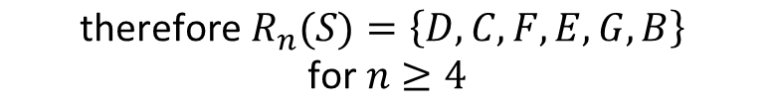




Example
A
A
A
A
B
C
D
B
C
D
B
C
D
B
C
D
E
F
E
F
E
F
E
F
G
G
G
G
$$S=\{D\}$$
$$R_{0}(S)=\{D\}$$
$$R_{1}(S)=\{D,C,F\}$$
$$R_{2}(S)=\{D,C,F,E,G\}$$
$$R_{3}(S)=\{D,C,F,E,G,B\}$$
This only works if the graph is finite. If the graph is infinite, this might run forever.
$$R_{4}(S)=\{D,C,F,E,G,B\}$$
$$\text{therefore} R_{n}(S)=\left\{D,C,F,E,G,B\right\}$$
$$\text{for} n≥4$$

Slide 17
Termination Reasoning
Halting measure: the number of white nodes
This is always a non-negative integer
Every step takes a white node and colors it green, so the number of white nodes decreases.
If there is no such node, the algorithm halts.
This assumes the graph is finite!! If the graph is infinite, the algorithm might not halt. The termination reasoning here wouldn't apply in an infinite graph, because the number of white nodes in an infinite graph is not an integer.

Slide 18
Closure problems
This is called a "closure problem": we want to find the smallest set R which contains our starting set S and which is closed under some operation
In this case, we want to find the smallest set that contains our starting set of nodes, and which is closed under all-successors.

Slide 19
Assumptions
We assume we've got data definitions for Node and Graph, and functions
node=? : Node Node -> Boolean
successors :
Node Graph -> SetOfNode
all-successors :
SetOfNode Graph -> SetOfNode
We also assume that our graph is finite.

Slide 20
Writing this as a function
;; reachables.v1 : SetOfNode Graph -> SetOfNode
;; GIVEN: A set of nodes in a finite graph
;; WHERE:
;; reached = the set of nodes reachable in
;; graph g in at most steps from a
;; set of nodes S, for some n and
;; some set of nodes S.
;; RETURNS: the set of nodes reachable from S.
;; STRATEGY: recur on reached + their immediate
;; successors
;; HALTING MEASURE: the number of nodes in g
;; NOT in reached.

Slide 21
Function Definition
(define (reachables.v1 reached g)
(local
((define candidates
(all-successors reached g)))
(cond
[(subset? candidates reached) reached]
[else (reachables.v1
(set-union candidates reached)
g)])))

Slide 22
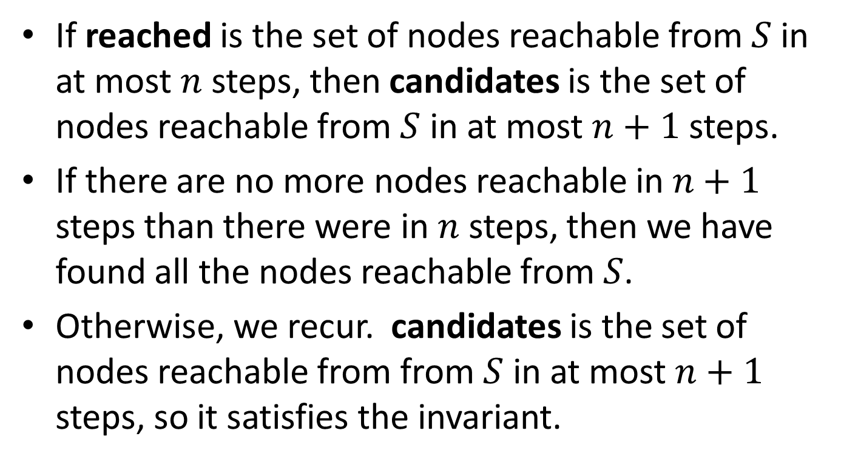
Correctness Reasoning
If reached is the set of nodes reachable from $S$ in at most $n$ steps, then candidates is the set of nodes reachable from $S$ in at most $n+1$ steps.
If there are no more nodes reachable in $n+1$ steps than there were in $n$ steps, then we have found all the nodes reachable from $S$.
Otherwise, we recur. candidates is the set of nodes reachable from from $S$ in at most $n+1$ steps, so it satisfies the invariant.

Slide 23
Termination Reasoning
At the recursive call, candidates contains at least one element that is not in reached (otherwise the subset? test would have returned true).
Hence the result of the set-union is at least one element bigger than reached. So the halting measure decreases.

Slide 24
Problem with this algorithm
We keep looking at the same nodes over and over again:
we always say (all-successors reached), but we've seen most of those nodes before.

Slide 25
A Better Idea: keep track of which nodes are newly found
S
only need to explore nodes in this region– all others are accounted for.

Slide 26
Do this with an extra argument and an invariant
S
recent = nodes reached in n steps but not in n-1 steps
reached = nodes reached in < n steps

Slide 27
Version with invariant
;; reachables1: SetOfNode SetOfNode Graph -> SetOfNode
;; GIVEN: two sets of nodes and a finite graph g
;; WHERE:
;; reached is the set of nodes reachable in graph g in fewer than n steps
;; from a set of nodes S, for some S and n, and
;; recent is the set of nodes reachable from S in n steps but
;; not in n-1 steps.
;; RETURNS: the set of nodes reachable from S in g.
(define (reachables1 reached recent g)
(cond
[(empty? recent) reached]
[else
(local
((define next-reached (append recent reached))
(define next-recent
(set-diff (all-successors recent g)
next-reached)))
(reachables1 next-reached next-recent g))]))
Since next is disjoint
from reached, we can replace the set-union with append.

Slide 28
Example
A
A
A
A
B
C
D
B
C
D
B
C
D
B
C
D
E
F
E
F
E
F
E
F
G
G
G
G
unexplored
in recent
in reached

Slide 29
Correctness Reasoning
If the invariant is true and recent is empty, then there are no more nodes reachable in n steps than in n-1 steps. So reached contains all the reachable nodes.
Otherwise, if the invariant is true, then next-reached is the set of nodes reachable from S in fewer than n+1 steps. next-recent is the set of nodes reachable from S in fewer than n+1 steps but not in fewer than n steps.
Since next and reached are disjoint, then (append next reached) is a set (that is, no duplications), and is the set of nodes reachable from S in fewer than n+1 steps. So the recursive call to reachables1 satisfies the invariant.

Slide 30
Termination Reasoning
If the invariant is true, then next is non-empty, so at the recursive call the number of nodes not in reached is smaller at the recursive call.

Slide 31
Initializing the invariant
;; reachables.v2 : SetOfNode Graph -> SetOfNode
;; GIVEN: A set of nodes in a finite graph
;; RETURNS: the set of nodes reachable from S.
;; STRATEGY: Call a more general function
(define (reachables.v2 nodes g)
(reachables1 empty nodes g))

Slide 32
Correctness Reasoning
There are no nodes reachable from nodes in fewer than 0 steps. The set of nodes reachable from nodes in at most 0 steps is just nodes. So the call to reachables1 satisfies reachable1's invariant.

Slide 33
Termination Reasoning
No termination reasoning is necessary here because this function simply calls reachables1, and we already know reachables1 terminates.

Slide 34
This is called the "worklist" algorithm
This is the simplest example of what's called a "worklist" algorithm.
It is used in many applications
in compiler analysis
in AI (theorem proving, etc.)

Slide 35
You could use this to define reachable?
;; reachable? : Graph Node Node -> Boolean
;; GIVEN: a graph and a source and a
;; target node in the graph
;; RETURNS: true iff there is a path in g
;; from src to tgt
;; STRATEGY: call more general function
(define (reachable? graph src tgt)
(member tgt (reachables (list src) graph)))

Slide 36
Or you could just wait for tgt to show up as you build the list of reachables
;; reachable-from? : SetOfNodes SetOfNodes Node Graph
;; GIVEN: two sets of nodes, a node, and a graph
;; WHERE:
;; reached is the set of nodes reachable in graph g in fewer than n steps
;; from some starting node 'src', for some n
;; recent is the set of nodes reachable from src in n steps but
;; not in n-1 steps.
;; AND tgt is not in reached
;; RETURNS: true iff tgt is reachable from src in g.
(define (reachable-from? reached recent tgt g)
(cond
[(member tgt recent) true]
[(empty? recent) false]
[else
(local
((define next-reached (append recent reached))
(define next-recent
(set-diff (all-successors recent g)
next-reached)))
(reachable-from? next-reached next-recent tgt g))]))

Slide 37
Correctness Reasoning
If the invariant is true and tgt is in recent, then tgt is reachable from src. If the invariant is true and recent is empty, then reached consists of all the nodes that are reachable from src. According to the invariant, tgt is not in reached, so tgt is not reachable from src.
Otherwise, we need to check that the recursive call satisfies the invariant. Since next and reached are disjoint, then (append next reached) is a set (that is, no duplications), and is the set of nodes reachable from src in fewer than n+1 steps. next-recent is exactly the set of nodes reachable from src in n+1 steps but not in n steps (because of the set-diff). Last, tgt is not in reached or in recent, so it is not in next-reached. So the recursive call to reachables1 satisfies the invariant.

Slide 38
Termination Reasoning
If the invariant is true, then recent is non-empty, so at the recursive call the number of nodes not in reached is smaller.

Slide 39
Another topic: changing the data representation
;; reachables: SetOfNode Graph -> SetOfNode
(define (reachables reached g)
(local
((define candidates (all-successors reached g)))
(cond
[(subset? candidates reached) reached]
[else (reachables
(set-union candidates reached)
g)])))
Notice that the only thing we do with graph is to pass it to all-successors.

Slide 40
So let’s represent the graph by its all-successors function
;; reachables: SetOfNode (SetOfNode -> SetOfNode)
;; -> SetOfNode
(define (reachables nodes all-successors-fn)
(local
((define candidates (all-successors-fn nodes)))
(cond
[(subset? candidates nodes) nodes]
[else (reachables
(set-union candidates nodes)
all-successors-fn)])))
Instead of passing in the graph, we'll pass in its all-successors function.

Slide 41
How do you build an all-successors-fn?
;; You could do it from a data structure:
;; Graph -> (SetOfNode -> SetOfNode)
(define (make-all-successors-fn g)
(lambda (nodes)
(all-successors nodes g)))

Slide 42
Or you could avoid building the data structure entirely
Just define a successors function from scratch, and then define all-successors using a HOF.
Good thing to do if your graph is very large– e.g. Rubik’s cube.

Slide 43
Example of an “implicit graph”
;; Int -> SetOfInt
;; GIVEN: an integer
;; RETURNS: the list of its successors in the implicit graph.
;; For this graph, this is always a set (no repetitions)
(define (successors1 n)
(if (<= n 0)
empty
(local
((define n1 (quotient n 3)))
(list n1 (+ n1 5)))))
A portion of this graph….
6
2
7
From Examples/08-8-implicit-graphs.rkt
0
5
1

Slide 44
;; all-successors1 : SetOfInt -> SetOfInt
;; GIVEN: A set of nodes
;; RETURNS: the set of all their successors in our implicit graph
;; STRATEGY: Use HOFs map, then unionall.
(define (all-successors1 ns)
(unionall (map successors1 ns)))
Here’s a function you could pass to reachables.

Slide 45
Summary
We've applied General Recursion to an important problem: graph reachability
We used invariants to capture and describe important properties of our functions.
We used list abstractions to make our program easier to write
We considered representing graphs by functions, rather than by data structures.

Slide 46
Lesson Summary
You should now be able to:
explain what a directed graph is, and what it means for one node to be reachable from another
explain what a closure problem is
explain how each of our functions for reachability works.
explain the correctness and termination of each of our algorithms by referring to their invariants.
write similar programs for searching in graphs.

Slide 47
Next Steps
Study 08-7-reachability.rkt and 08-8-implicit-graphs.rkt in the Examples folder.
If you have questions about this lesson, ask them on the Discussion Board
Do Guided Practice 8.4

